Slide 1
E-COMMERCE PROJECT For Online Retails Company

Slide 2

Members
Consultant
Md. Moshaidul Islam
Wdpf.id-bisew it scholarship
moshaidul@gmail.com
Instructor
Farhana Akter Lucky
Wdpf.id-bisew it scholarship
farhana_lucky25@gmail.com
Submitted By
Mst. Farhana Akter
Trainee ID: 1287997
Batch: WDPF/NCLC-M/65/01
mstfarhanaaktersh@gmail.com

Slide 3
Application
10th August, 2025
The Consultant
WDPF.IDB-BISEW
Sher-e-Bangla Nagar, Dhaka-1207
Subject: Project proposal for E-Commerce system
Dear Sir,
I hope this letter finds you well. I am writing to propose an innovative project for the development of an Online E-Commerce System. this project aims to provide a seamless and user-friendly solution to cater to the growing demand for online E-Commerce services.
My proposed project will allow customers to browse, select, and book product from the comfort of their homes or on the go. This platform will provide a range of features to streamline the product booking process.
Thank you for considering our proposal. I look forward to the opportunity to discuss this project with you and potentially move forward with its implementation.
Sincerely,
Mst. Farhana Akter
Trainee ID: 1287997
Batch: PWDF/NCLC-M/65/01
Email: mstfarhanaaktersh@gmail.com

Slide 4
INDEX
Serial No. | Contents | Page No.
01 | Project Background and Objective | 05-06
02 | Software Features and Scope | 07-08
03 | Entity Relationship Diagram | 09
04 | Flowchart of Process | 10
05 | Milestone/Timeline | 11
06 | Use Of Tools And Technology | 12
07 | Server Configuration | 13
08 | Information Source and Reference | 14
09 | Demo Images | 15-17

Slide 5
Project Background
Online shopping has become a big part of daily life. People want convenience, variety, and quick delivery. E-commerce platforms make it possible to shop anytime and anywhere without visiting physical stores. This project is about building an e-commerce platform that allows customers to shop online with ease. The website will display a variety of products, provide detailed information, and allow secure purchasing. It will also give sellers the tools to manage products, orders, and customers. The aim is to create a platform that is fast, reliable, and easy for everyone to use.

Slide 6
Project Objective
Provide a simple and user-friendly online shopping experience
Allow customers to search, browse, and buy products anytime, anywhere
Offer secure payment and quick order tracking
Help sellers manage their products, sales, and customer data efficiently
Expand business reach beyond physical store limits

Slide 7
Software Features
User-Friendly Interface – Easy navigation for all users
Product Search & Filters – Find items quickly by category, price, or brand
Product Details – Images, descriptions, prices, and reviews
Shopping Cart & Wishlist – Save or buy products anytime
Secure Payment Gateway – Multiple payment options with safety
Order Tracking – Check delivery status in real time
User Accounts – Manage profile, orders, and preferences
Admin Dashboard – Manage products, orders, and customers

Slide 8
Software Scope
Available for both desktop and mobile devices
Supports multiple product categories (electronics, fashion, etc.)
Can be used by individual sellers and businesses
Secure and scalable for future expansion
Integrated with payment systems and shipping partners
Potential to add discounts, promotions, and loyalty programs in future updates

Slide 9
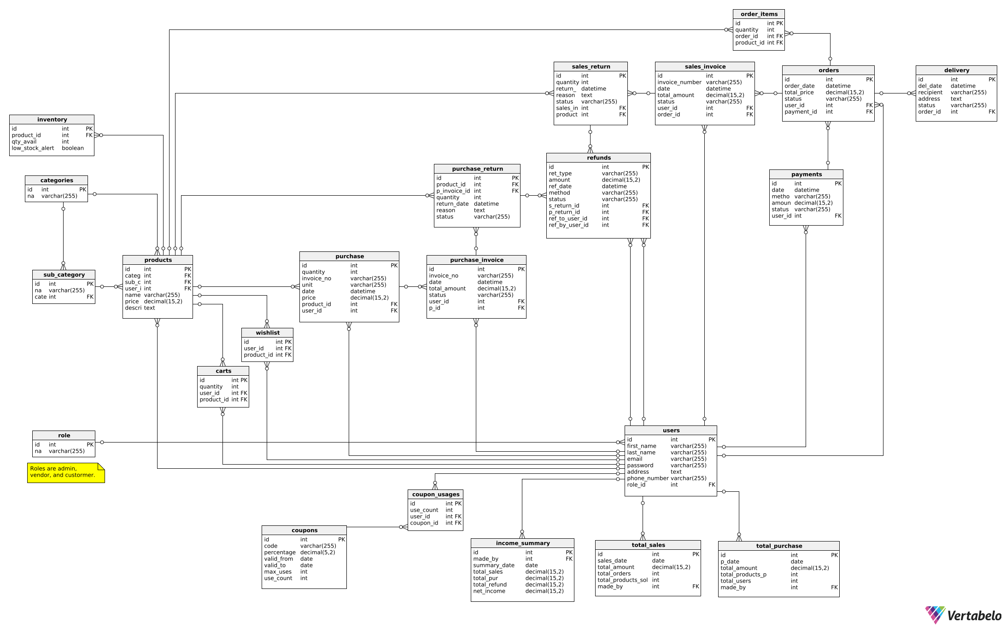
ER Diagram

Slide 10
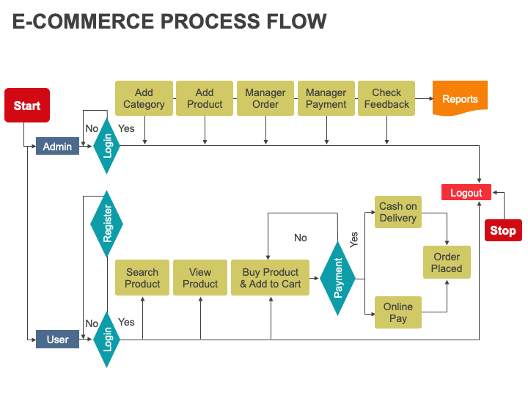
Flowchart of Process

Slide 11
Timeline And Milestone:
Milestone | Duration (Days)
Requirements Gathering | 2
Design and User Interface | 5
Development and Coding | 13
Testing and Quality Assurance | 5
Deployment and Launch | 2
Project Completion and Handover | 1
Total Duration | 30

Slide 12
Use Of Tools And Technology
Front-End
HTML5 | For creating the structure and content of web pages
CSS3 | For styling and layout of the application.
Bootstrap | For responsive and mobile-first design.
JavaScript | For adding interactivity and dynamic content.
jQuery | A JavaScript library for easier front-end web interactions.
Back-End
PHP | For server-side scripting and logic.
MySQL | For database management and storage of all data (e.g., users, products, orders).

Slide 13
Server Configuration
Server Software Configuration
Operating System: Windows 7 and higher
Language: PHP
Database: MySQL
Server Hardware Configuration:
Processor: Intel(R) Core(TM) 2Duo CPU @ 2.93 GHz
RAM: 2 GB
Hard Disk Drive: 20 GB
Keyboard: 122 Keys

Slide 14
Information Source and Reference
Information Source | Description
PHP.net | Official documentation and reference for PHP programming language
MySQL.com | Official documentation and resources for MySQL database management System
W3Schools | Online tutorials and guides for web development technologies, including PHP and MySQL
Stack Overflow | Online community for programmers to ask and answer technical questions
GitHub Repositories | Open-source projects and code repositories for PHP and MySQL

Slide 15
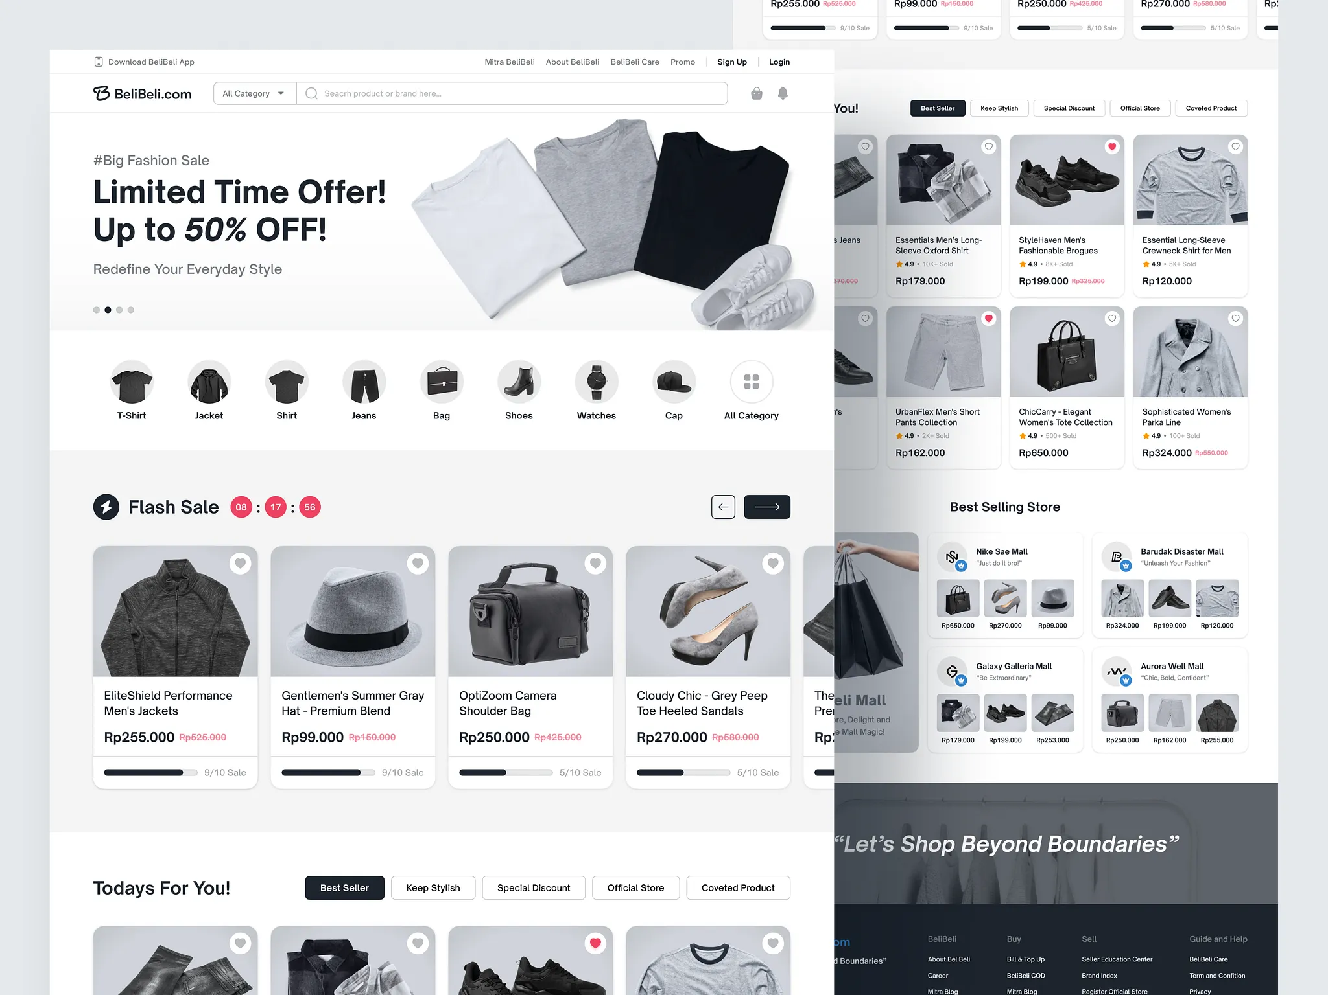
E-Commerce UI

Slide 16
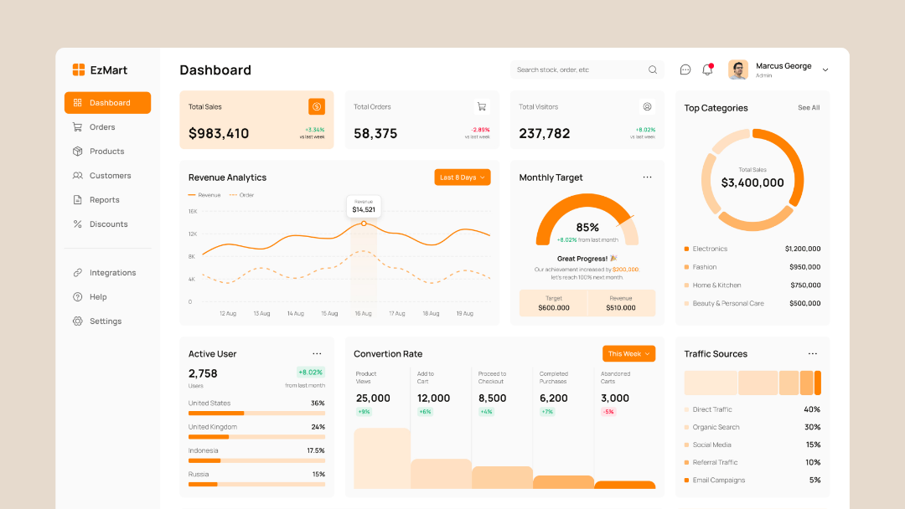
Admin Panel

Slide 17
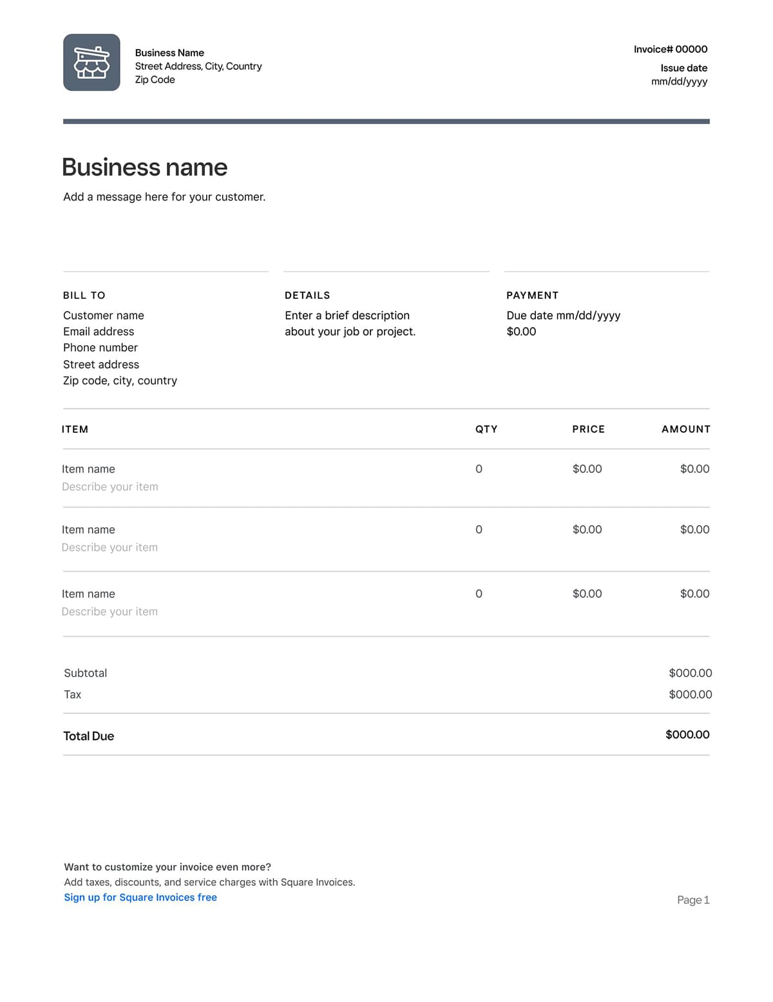
Invoice

Slide 18
Do you have any questions?
Thank you
Presented by: Mst. Farhana Akter Project: E-Commerce Platform

